Slide 1
Cozmo Project
By Jingxian, Jordan, Jamie and Zhiwei

Slide 2
Features

Slide 3
Features
Jingxian
Pick up a cube
Place the cube on top of another cube when tapped
Celebrate
Jordan
Turn 15 degree clockwise, move forward 1 time and repeat until face seen
Once face seen, it will say “Hi, welcome to SIT”
Then it will get excited and dance.

Slide 4
Features
Zhi Wei
Avoiding the CUBE
Step 1:Drive forward
Step 2:By facing the cube,turn 90 degree,drive for a certain distance then turn -90 degree.
Step 3:If it faces cube again,repeat step 1
Step 4:If there’s no cube in front,drive forward
Jamie
pyramid

Slide 5
Challenges Faced

Slide 6
Challenges Faced
Jing xian
Had difficulty figuring out why Cozmo’s arm keep going back down
By trial and error, use the raise Cozmo’s arm code twice.
Jordan
Struggled to find the “if face seen” then “...”
Also the cosmo had difficulty finding a face as the head was facing forward so I had to add a tilt head upwards by 30 degree in order for the cosmo to find a face.
Notes:
Ill take this slide - Jx

Slide 7
Challenges Faced
Zhi Wei
Facing the cube while turning
For example, while turning 90 degree and facing another cube,it repeat step 2
This causes it to turn more than 90 degree
Solution:Broadcast step 1 and wait for it to finish instead of just broadcasting it
Jamie

Slide 8
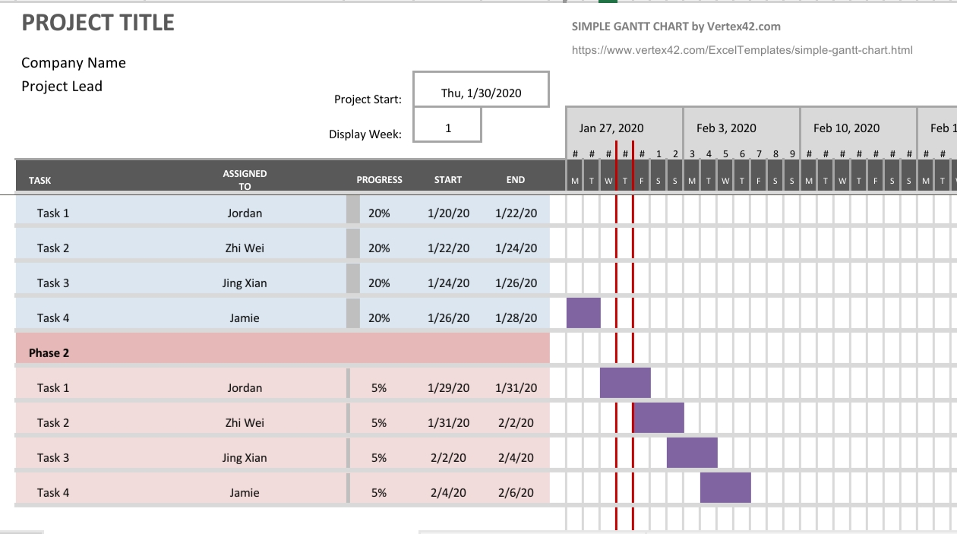
Gantt Chart

Slide 9
DEMO

